Slide 1

How to Submit a Good Abstract for #ESA2021
Sarah Emery, 2021 Program Chair
Kiona Ogle, 2020 Program Chair
Sarah Anderson, Meetings Committee
Christi Nam, Director, Conventions and Meetings
Jennifer Riem, Meeting Program Associate
https://www.esa.org/longbeach/

Slide 2
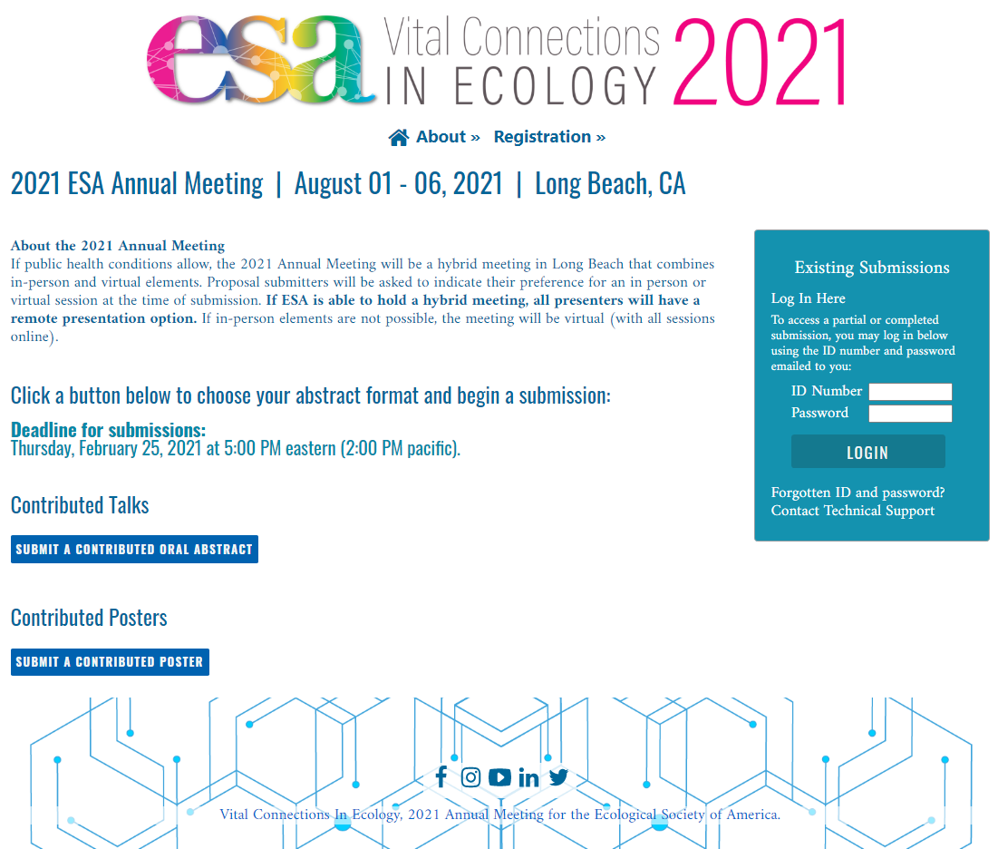
Notes:
Submission page overview. Click “Submit” for each proposal type to begin a new submission. Proposal submission link: https://eco.confex.com/eco/2021/cfp.cgi
Existing submissions can be accessed by entering the ID and password in the box on the right-hand side of the screen. This ID and password is unique to every abstract submission. It’s not your member number. You should have received ID and password after completing the first step of your abstract submission.

Slide 3
Notes:
Submission page overview. Click “Submit” for each proposal type to begin a new submission. Proposal submission link: https://eco.confex.com/eco/2021/cfp.cgi
Existing submissions can be accessed by entering the ID and password in the box on the right-hand side of the screen. This ID and password is unique to every abstract submission. It’s not your member number. You should have received ID and password after completing the first step of your abstract submission.

Slide 4
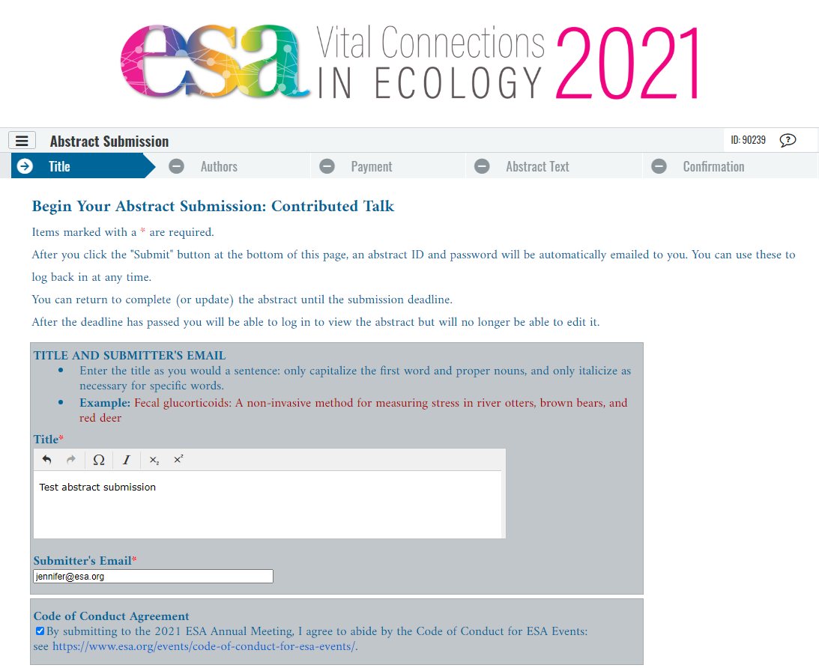
Notes:
Each abstract submission has 4-5 steps – Title, Authors, Payment (Talks Only, Optional), Abstract Text, and Confirmation. This example is for a talk.
After clicking “Save” at the bottom of this page you have completed the first step of submission. An automated email with the ID and password will be sent to the email address entered as Submitter’s Email Address. You can use these to return to edit/complete your submission until the deadline.

Slide 5
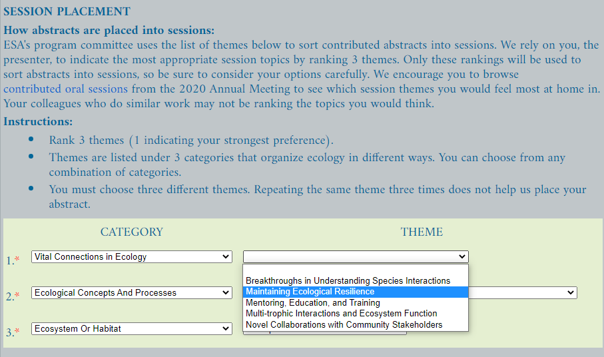
Notes:
Each abstract submission has 4-5 steps – Title, Authors, Payment (Talks Only, Optional), Abstract Text, and Confirmation. This example is for a talk.
After clicking “Save” at the bottom of this page you have completed the first step of submission. An automated email with the ID and password will be sent to the email address entered as Submitter’s Email Address. You can use these to return to edit/complete your submission until the deadline.

Slide 6
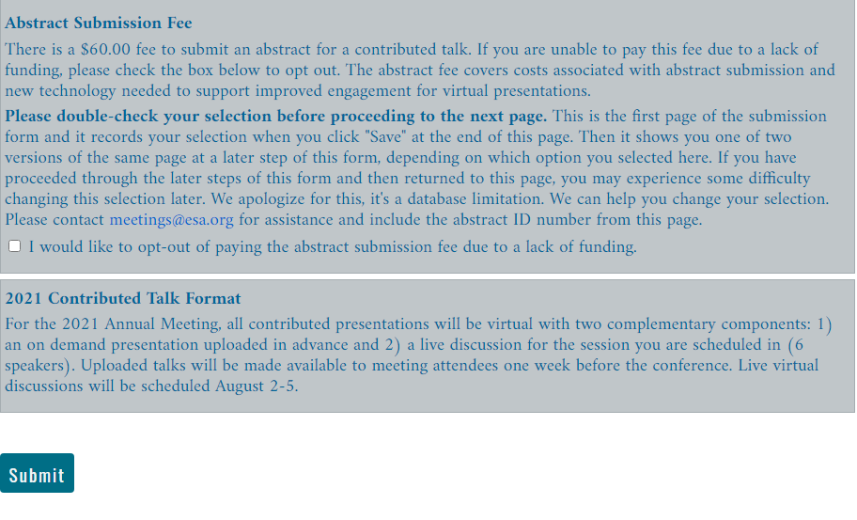
Notes:
Each abstract submission has 4-5 steps – Title, Authors, Payment (Talks Only, Optional), Abstract Text, and Confirmation. This example is for a talk.
After clicking “Save” at the bottom of this page you have completed the first step of submission. An automated email with the ID and password will be sent to the email address entered as Submitter’s Email Address. You can use these to return to edit/complete your submission until the deadline.

Slide 7
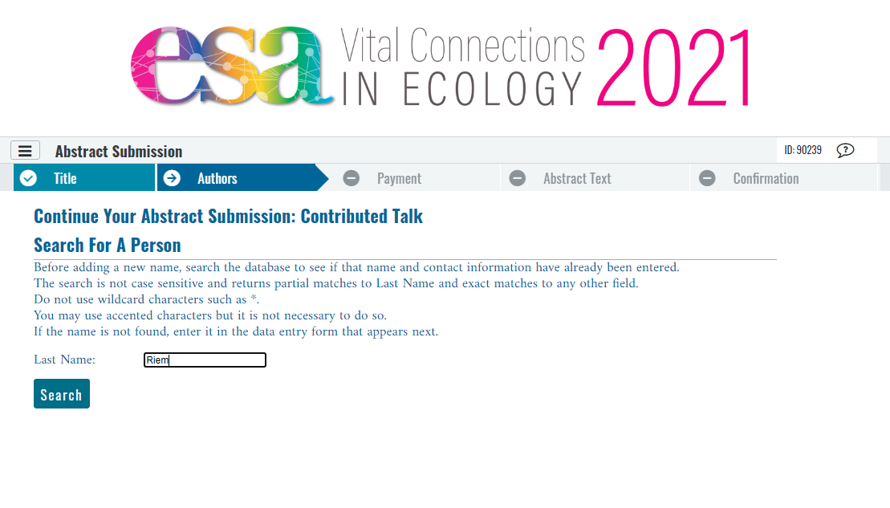
Notes:
Authors page – this is showing the start of a search by last name to add a person to the author list.

Slide 8
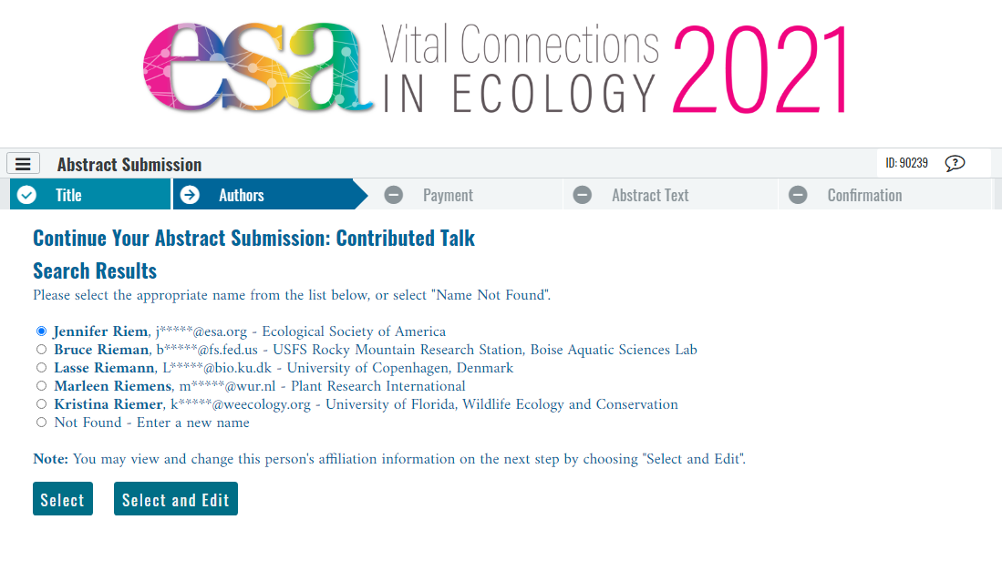
Notes:
Authors page – this is showing how to add an author from the search results. You can choose “Select and Edit” to update an author’s name, affiliation, or email address.

Slide 9
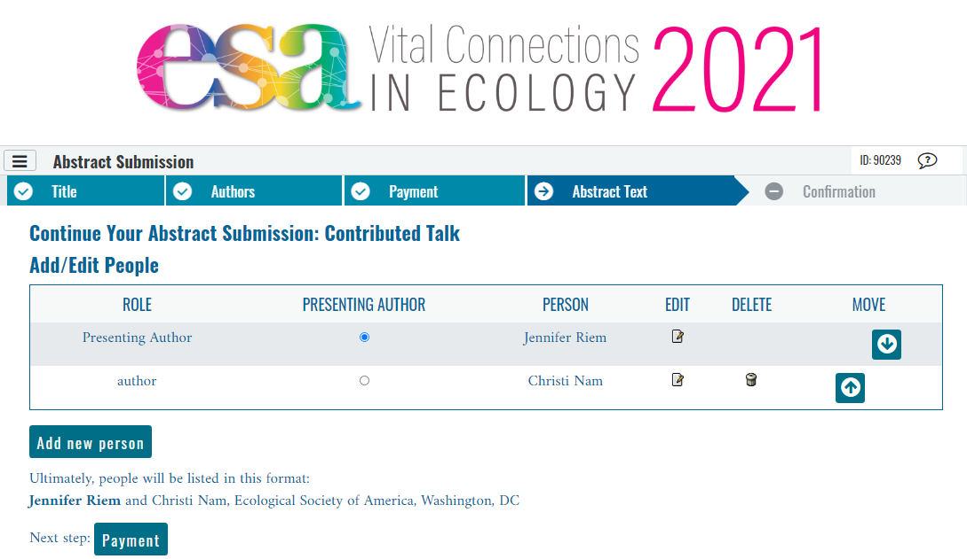
Notes:
Authors page – this is showing the presenting author and one coauthor have been entered. You can use the radio buttons under presenting author to select who will be the presenter (it can be anyone in the author list). You can use the arrows to reorder the list.

Slide 10
Notes:
Authors page – this is highlighting the author listing preview. This shows you exactly how the author list will appear in the program. Affiliations must match exactly for all fields you have filled in (institution, department, city, state, zip code, country) if you want the affiliations to be listed together as shown here.

Slide 11
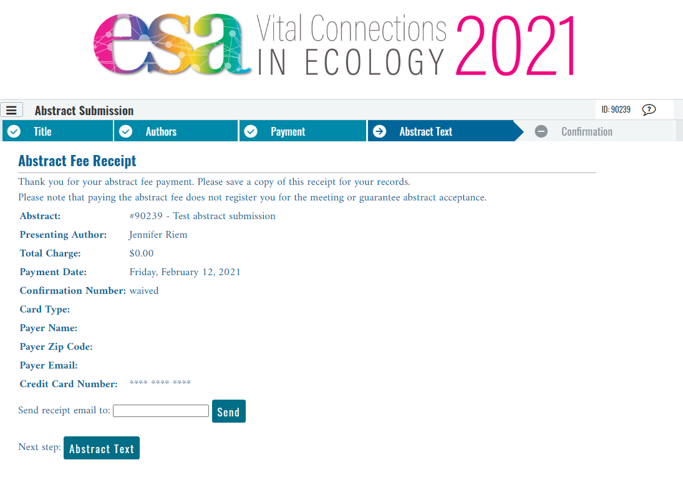
Notes:
Payment Step. This example shows an abstract for a talk where the fee waiver box was checked.

Slide 12
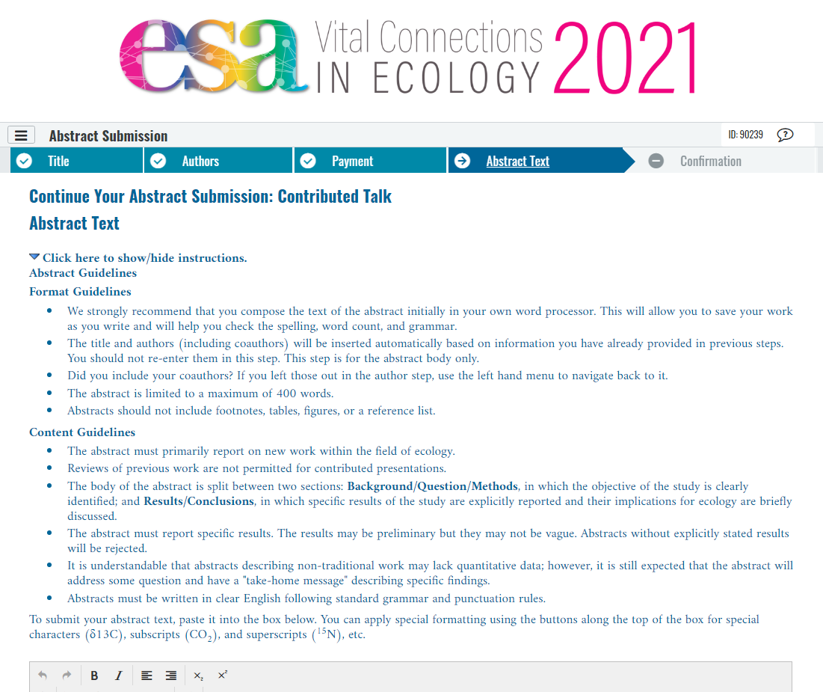
Notes:
This is the Abstract Text page. First we will focus on the instructions at the top of the page, then the abstract text entry below. Please read the instructions! They are here to help you and address the most common issues we see.

Slide 13
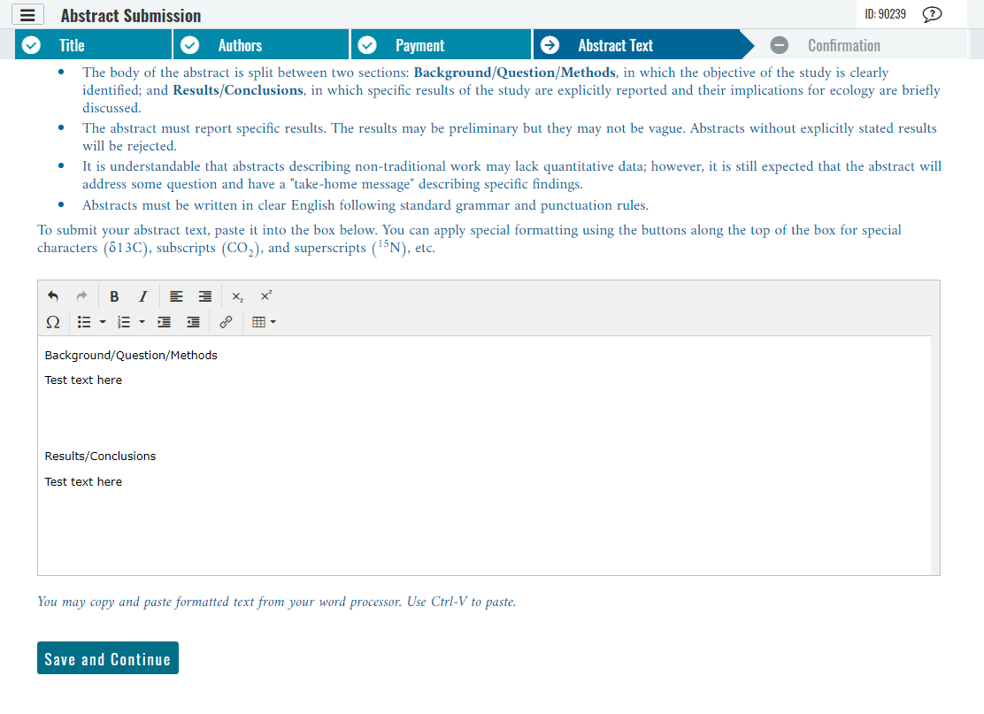
Notes:
This is the Abstract Text page. The two headings will automatically appear in the box. If you replace them, make sure they match exactly, or you will see an error message when you try to save and continue. If in doubt, you can always paste if from the instructions at the top of the page.

Slide 14
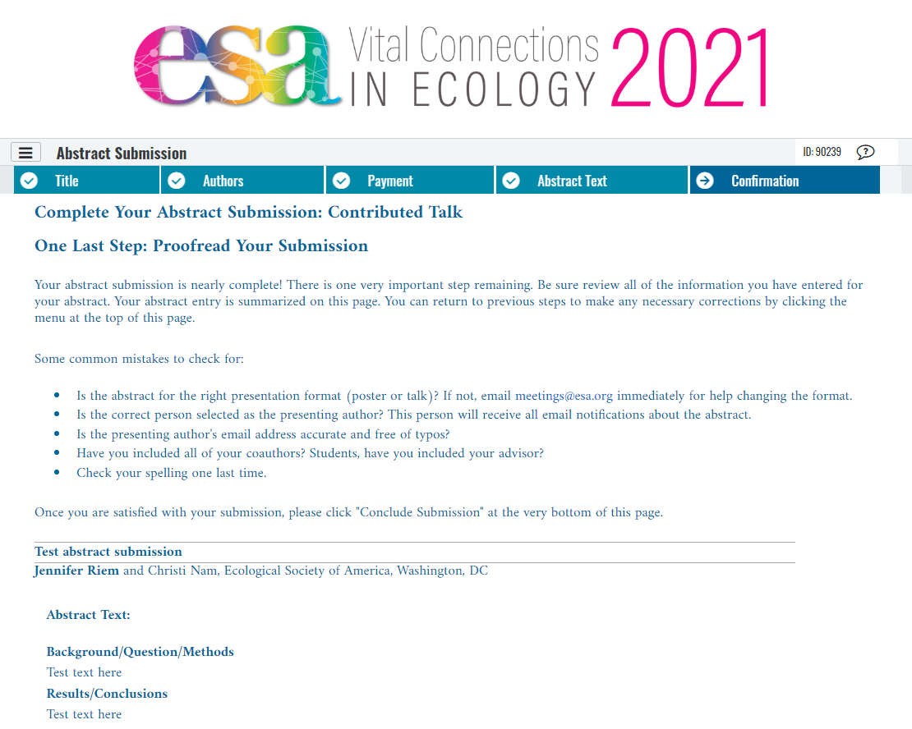
Notes:
Confirmation Step – Please proof your work! Click “Conclude Submission” at the bottom of the page to complete your submission. The presenting author will receive an automated email confirming the abstract has been submitted. The link in that email can be used to return to the abstract to edit it until the deadline has passed.

Slide 15
Notes:
Confirmation Step – Please proof your work!

Slide 16
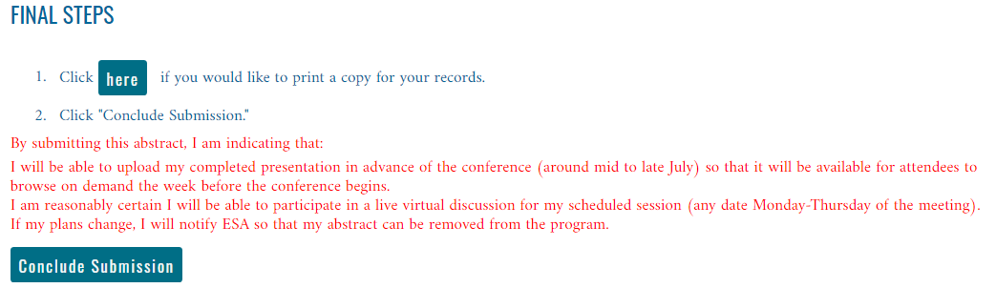
Notes:
Confirmation Step – To complete your submission, click “Conclude Submission” at the bottom of the page. The presenting author will receive an automated email confirming the abstract has been submitted. The link in that email can be used to return to the abstract to edit it until the deadline has passed.

Slide 17
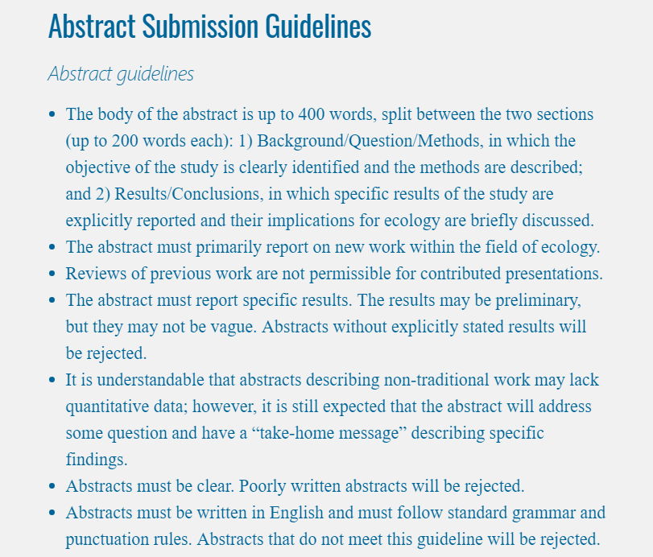
Notes:
Abstract guidelines

Slide 18

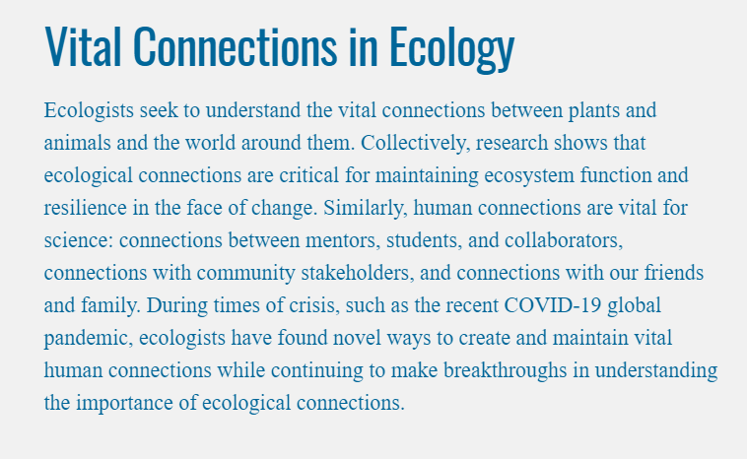
How to Submit
a Good Abstract
for #ESA2021
2021 Meeting Theme
Notes:
This year’s meeting theme. Matching the theme is not required. Most abstracts don’t.

Slide 19
How to Submit a Good Abstract for #ESA2021
Questions after today?
Sarah Emery
2021 Program Chair
sarah.emery@louisville.edu
Jennifer Riem
Meeting Program Associate
jennifer@esa.org
https://www.esa.org/longbeach/

