Slide 1

Tips for Proposing a Workshop, Short Course or Special Session for #ESA2021
Sarah Emery, 2021 Program Chair
Kiona Ogle, 2020 Program Chair
Sarah Anderson, Meetings Committee
Ryan McEwan, 2019 Program Chair
Christi Nam, Director, Conventions and Meetings
Jennifer Riem, Meeting Program Associate
https://www.esa.org/longbeach/

Slide 2
Which should I propose?
Workshop
offers an opportunity to learn new skills
provides interactive instruction and hands-on training
short format (90-minutes)
not appropriate for formal research talks
requires advance signup
no additional fee
Short Course
offers an opportunity to learn new skills
provides interactive instruction and hands-on training
long format (3 hours or 6 hours)
not appropriate for formal research talks
requires advance signup
requires an additional fee
Special Session
offers an opportunity for extended dialogue
flexible format; innovative use of the session is encouraged
short format (60-minute)
not appropriate for formal research talks
no advance signup or fee

Slide 3

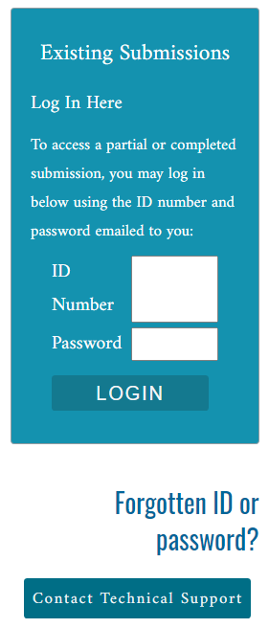
Notes:
Submission page overview. Click “Submit” for each proposal type to begin a new submission. Proposal submission link: https://eco.confex.com/eco/2021/cfs.cgi
Existing submissions can be accessed by entering the ID and password in the box on the right-hand side of the screen. This ID and password is unique to every proposal submission. It’s not your member number. You should have received ID and password after completing the first step of your proposal submission.

Slide 4
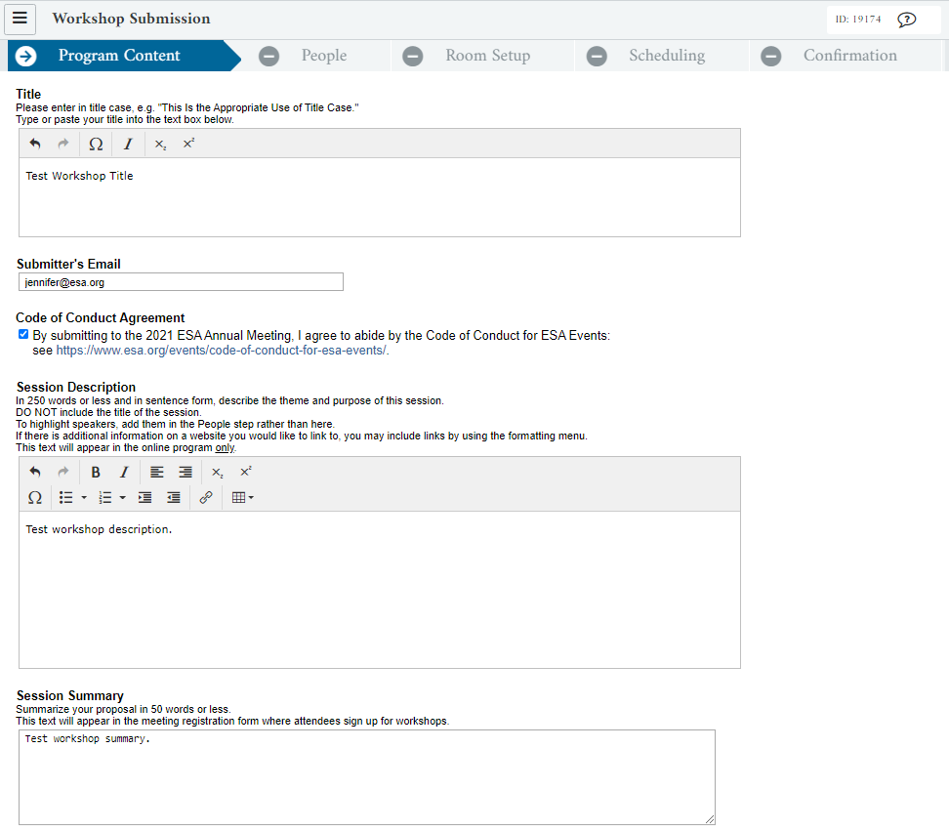
Notes:
Each proposal has 5 steps – Program Content, People, Room Setup, Scheduling, and Confirmation. This example is for a workshop proposal.
After clicking “Save” you have completed the first step of submission. An automated email with the ID and password will be sent to the email address entered as Submitter’s Email Address. You can use these to return to edit/complete your submission until the deadline.

Slide 5
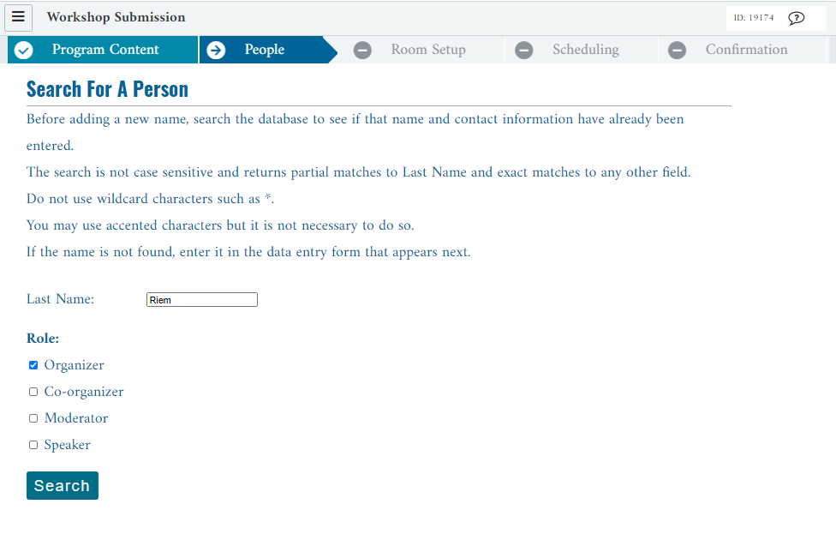
Notes:
People page – this is showing a last name search to add a person. Note that you should select the role(s) for the new person before proceeding. The system will adapt the list of options for roles as you enter more people. For example, if you have already added a session moderator, you will not see this option.

Slide 6
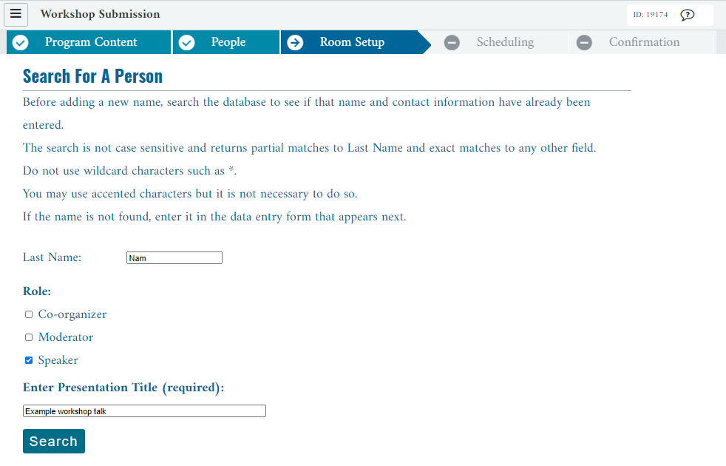
Notes:
Add People page – this is showing how to add a speaker. The prompt to enter a presentation title appears after you check the Speaker box. The meeting program will list speakers and titles, not abstracts, since these are not paper sessions.

Slide 7
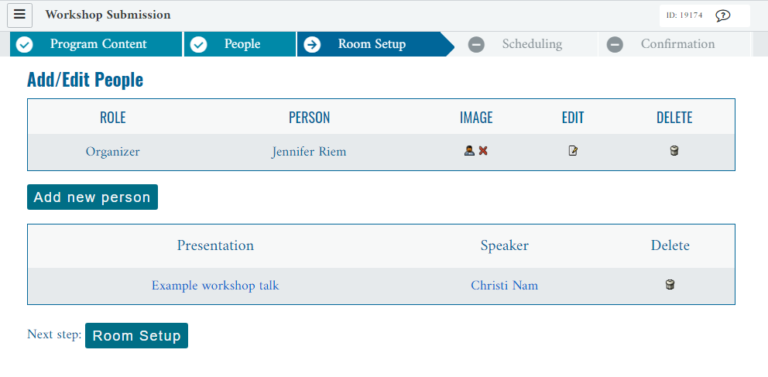
Notes:
People page – this is showing our completed example, one session organizer and one speaker entered.

Slide 8
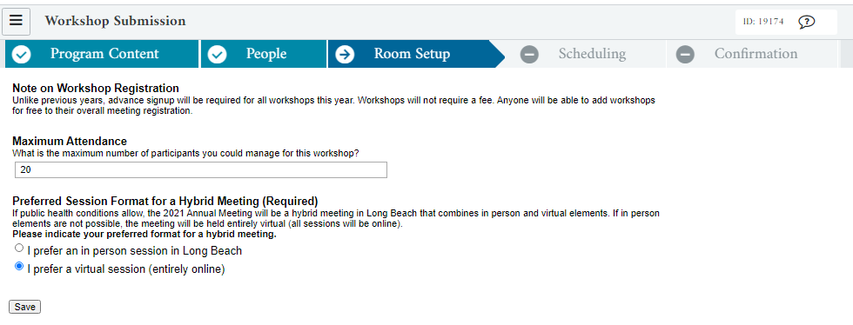
Notes:
Room Setup page – this is showing what the page looks like when you have selected a virtual session preference. After making this selection, you can proceed to the next page.

Slide 9
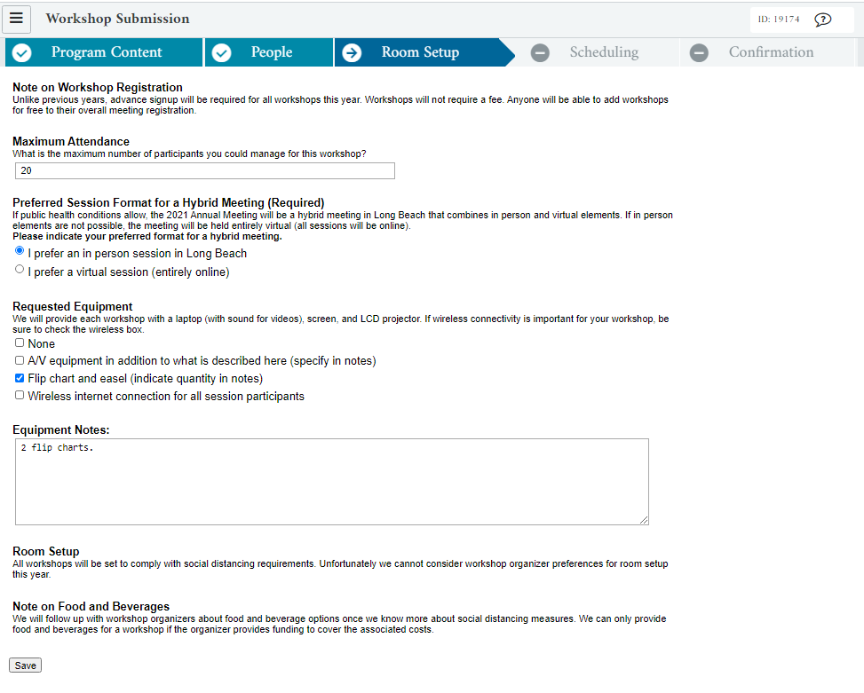
Notes:
Room Setup page – this is showing what the page looks like when you have selected an in person session preference. After making this selection, some logistical questions appear and should be answered before proceeding to the next page.

Slide 10
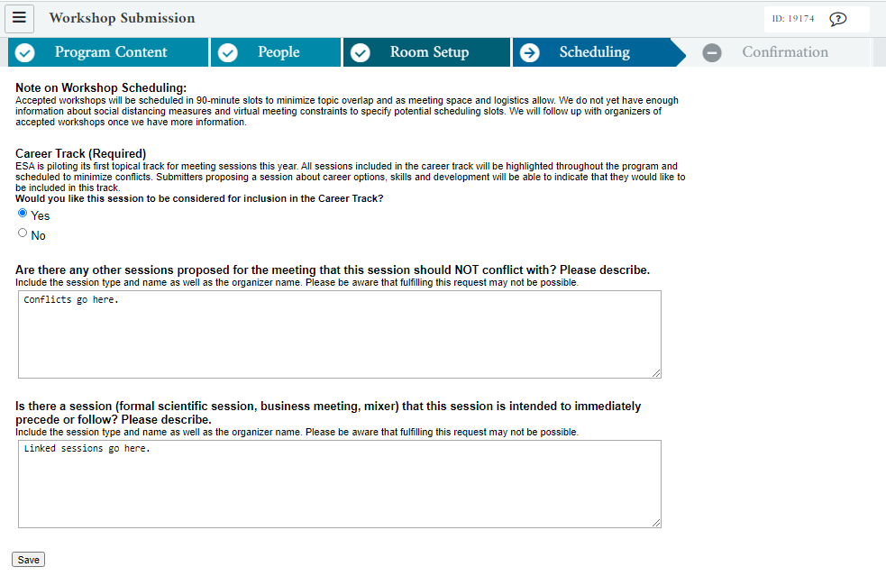
Notes:
Scheduling page. Unfortunately we know a lot less than usual about our scheduling options for next year. For now we are asking submitters to let us know about the Career Track, conflicting sessions, and linked sessions.

Slide 11
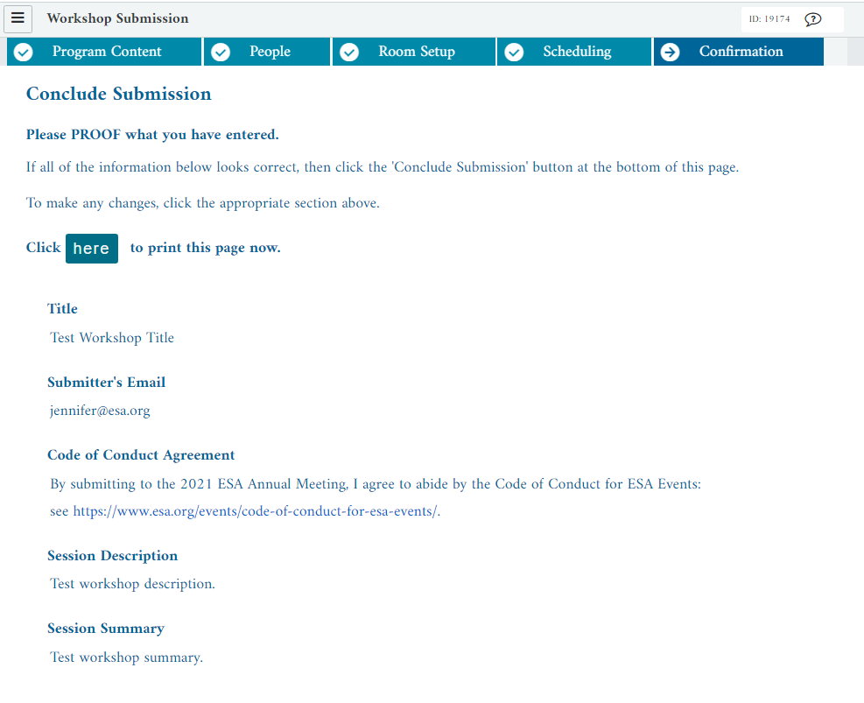
Notes:
Confirmation Step – Please proof your work! Click “Conclude Submission” at the bottom of the page to complete your submission. The Session Organizer will receive an automated email confirming the proposal has been submitted. The ID and password in that email can be used to return to the proposal to edit it until the deadline has passed.

Slide 12
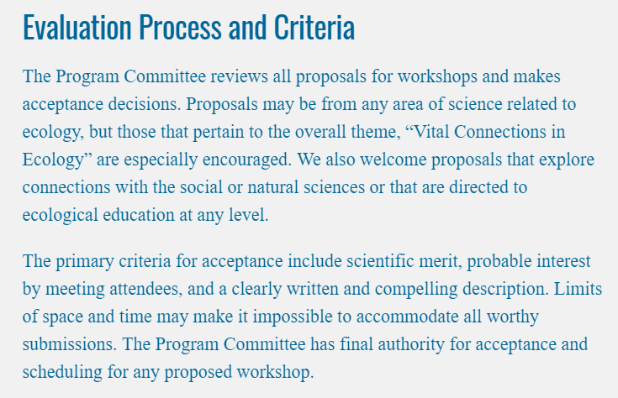
Proposal Guidelines
Notes:
Proposal guidelines. This example is for workshops but the same overall process is also true for short courses and special sessions. In practice they are all evaluated together.
https://www.esa.org/longbeach/program/workshops/
https://www.esa.org/longbeach/program/short-courses/
https://www.esa.org/longbeach/program/special-sessions/

Slide 13


Tips for Proposing a
Workshop, Short Course
or Special Session
for #ESA2021
2021 Meeting Theme

Slide 14
Tips for Proposing a Workshop, Short Course or Special Session for #ESA2021
Questions after today?
Sarah Emery
2021 Program Chair
sarah.emery@louisville.edu
Jennifer Riem
Meeting Program Associate
jennifer@esa.org
https://www.esa.org/longbeach/

